Slide 1
Module Code : 420 Module Name: Data Science Professional Practice 1 Candidate Number: 720027410
Notes:
Welcome everyone for joining the presentation, in this presentation we will be discussing about my organization and the way how Data Community works in my organization.

Slide 2

Data Science Lab Innovations June 2022
720027410
Notes:
Welcome everyone for joining the presentation, in this presentation we will be discussing about my organization and the way how Data Community works in my organization.

Slide 3

Hello!
I am a Data Engineer You can find me at sj565@exeter.ac.uk
720027410
Notes:
I’m a Data Engineer and I’m a BigData Engineer, my Exeter email id is sh565@Exeter.ac.uk

Slide 4
1.Who Am I ?
720027410

Slide 5
I’m a Data Engineer and my roles and responsibilities are finding trends in data sets and developing algorithms to help make raw data more useful to the enterprise.
720027410
Notes:
Data engineers build and maintain data systems. They construct datasets that are easy to analyze and support company requirements.
Data engineers implement methods to improve data reliability and quality. They combine raw information from different sources to create consistent and machine-readable formats. They also develop and test architectures that enable data extraction and transformation for predictive or prescriptive modeling.
Analyzing raw data
Developing and maintaining datasets
Improving data quality and efficiency
Interpret trends and patterns
Conduct complex data analysis and report on results
Prepare data for prescriptive and predictive modelling
Build algorithms and prototypes
Combine raw information from different sources
Explore ways to enhance data quality and reliability
Identify opportunities for data acquisition
Develop analytical tools and programs
Collaborate with data scientists and architects on several projects

Slide 6
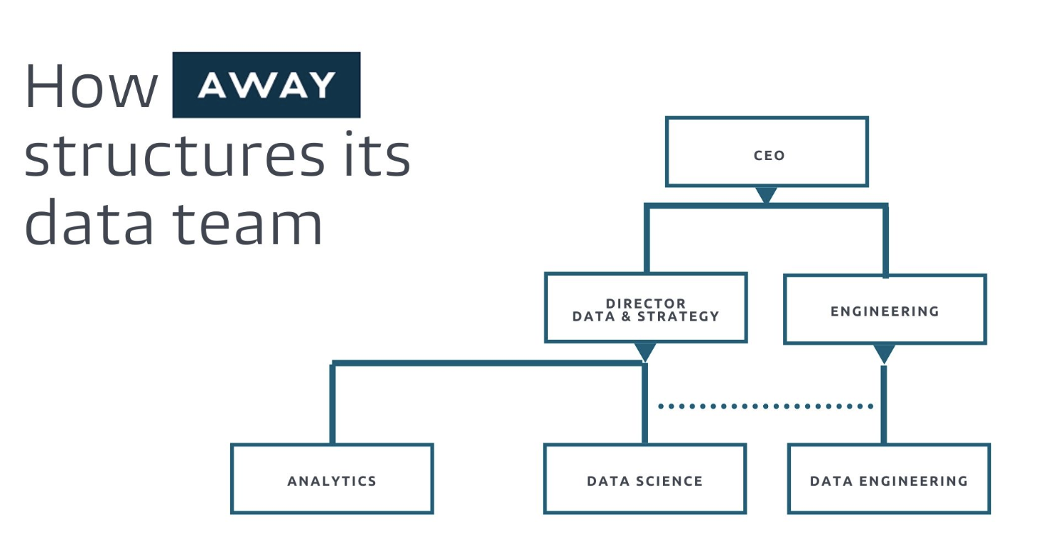
Organization Chart
720027410
Notes:
Organization Chart: This is my organization chart where we do have an Analytics team which basically works on Visualization part and the technologies they use like Tableau, PowerBi, Micro Strategy, Denodo. We do have a Data Science team where all the Data Scientist team works with the latest machine learning stuff, fulfilling client needs based on their requirements.
We also have a Data Engineering team where the internal stake holders are the Data Scientist, they get the requirements from Data Scientist and basically works on the producing the data. They construct datasets that are easy to analyze and support company requirements.
Data engineers implement methods to improve data reliability and quality. They combine raw information from different sources to create consistent and machine-readable formats. They also develop and test architectures that enable data extraction and transformation for predictive or prescriptive modeling.
Analyzing raw data
Developing and maintaining datasets
Improving data quality and efficiency
These responsibilities may vary based on each company's needs. When crafting your own data engineer job description, make sure to tailor them accordingly.

Slide 7
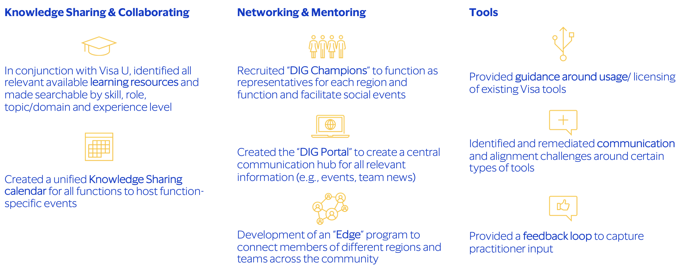
Data Community Program
720027410
Notes:
Data Community Program talks about three major things
Knowledge Sharing & Collaborating : Under Knowledge Sharing and Collaborating we have multiple resources using which users can take benefits for this career guidance. We do have a Visa University where all the participants enrolls and based on their interest, they will get trained by the instructor on the technology on which they are interested. Our organization also provides external resources like LinkedIn Learning, Plural Sight and O'Reilly Books.
Networking & Mentoring : We do have a champions community named as DIG Champions where we take multiple trainings sessions like an event so that at a global it will get benefitable for global organization. Along with the career path we will also conduct sports activity which keep all the participants active with the group and there is a good collaboration between all of them.
Tools : Our organization supports lot of tools which are paid as well as open source, we have a very good community which takes cares of all the tools licenses. We have worked on these licensing issues and saved good amount of dollars. For example Tableau license is very high and it got allocated to huge number of users which they do not use on their daily job. We had a survey and checked the usage of these license and got to know multiple users are not using so we came up with an idea. We are tracking the usage of the user and if he is not logging into Tableau for 90 days his license will get revoked. If he need it then he need to come up with a proper business use case.

Slide 8
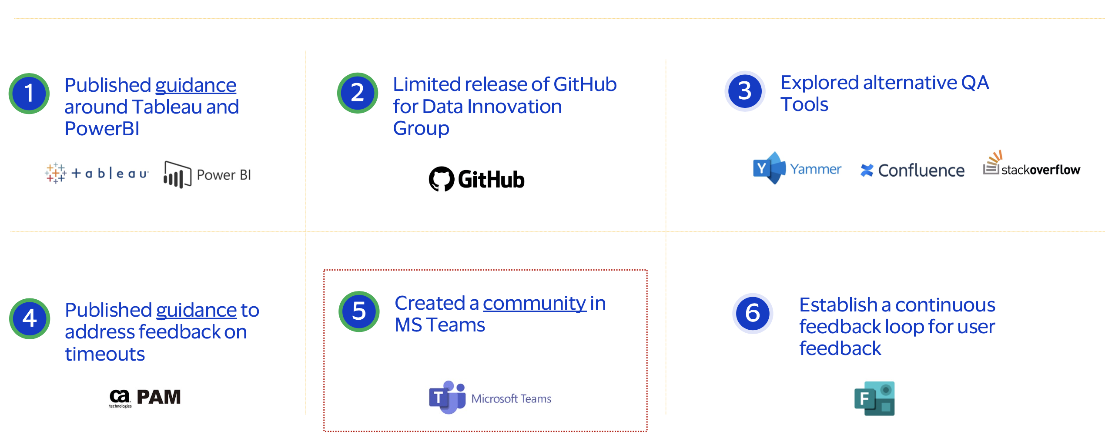
Tools Workstream
720027410
Notes:
Tools Workstream:
The landscape of business today is in a constant state of change, and data science makes a significant impact on the industry. As human interaction with technology grows by the day, the amount of data that is generated on a routine basis is immeasurable. This data is found in the raw form and is of immense value to business and research.
Data science aims at collecting, processing, analyzing, and presenting this data in a visual format to help companies or organizations in making crucial business decisions. This boom is one of the major reasons why data scientists are in high demand. According to LinkedIn Workforce Report, the demand for data scientists is increasing at a fast pace. Yet, the number of people who apply for these jobs is very low, reiterating the fact that though there is a high demand, the supply is stagnant. With the advent of the latest trends and updated technology, the data science field is expected only to grow larger. As a developing field, data science has an enormous scope to grow larger. The latest discoveries and trends have set it apart from major professions in ways more than one. To understand the opportunities this field holds, one must understand the emerging technologies in data science that are shaping the future, and for the better.
Artificial Intelligence
Cloud Services
AR/VR Systems
IoT
Big Data
Automated Machine Learning Our organization recently has been switched to latest tools form older one, like we have moved to github from bitbucket which has helped us some good amount of dollars and also all the users are comfortable using github. We have brought up some new QA tools which is helping testing team to perform application testing in a speedy and efficient way. We collaborate using Teams channel and also if we want to share any files then we do use sharepoint.

Slide 9
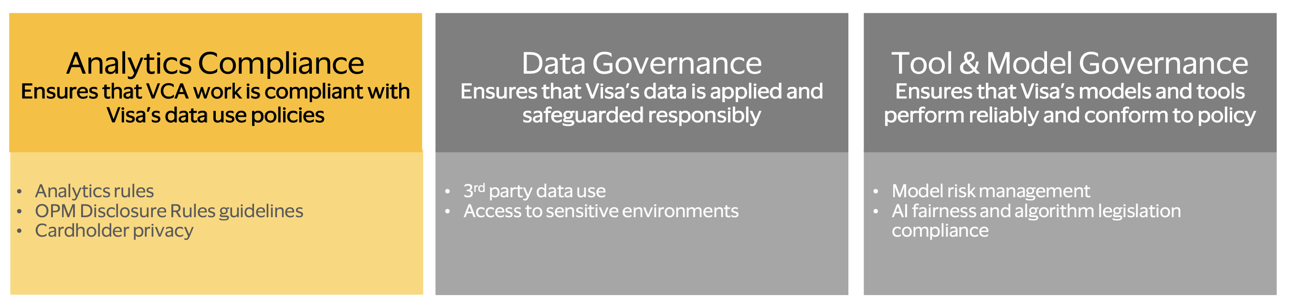
Data Compliance Center
720027410
Notes:
As we know, compliance analytics is “a growing category of information analysis, involves gathering and storing relevant data and mining it for patterns, discrepancies, and anomalies. It enables companies to better detect and head off potentially improper transactions before employees, third-parties, or even criminals steal or achieve other nefarious objectives.
Compliance analytics helps companies to proactively identify issues, take corrective action, and self-report to regulators on a timely basis.
To build a successful compliance analytics program, businesses must first focus on creating a transformational experience within the program, ensuring that everyone who may be affected is onboard with the program and is aware that it is coming down the pipeline.
Key personnel to include in the compliance program beyond the compliance department might include members of Financial Risk Management, Internal Audit Management, Tool and Model Governance, Data Governance, IT Risk and Compliance and Operational Risk Management departments. Depending on the organization, chief marketing officers and chief data officers may also be involved.
Once you have determined the key stakeholder that need to be involved in your compliance analytics program, the next step is to focus on the highest-areas of compliance risk. In my experience, the best way to identify areas of compliance risk, the processes needed to protect the organization, and the appropriate technology solution for your organization is to conduct compliance risk-assessment workshops. On a side note, throughout the thousands of these workshops CaseWare Analytics’ has conducted, we consistently find common failings across the organization include lack of understanding of the data; deficient documentation on policies and procedures; and absent controls monitoring. Without these in place, it becomes more difficult to optimize processes and your compliance analytics program will not succeed.

Slide 10
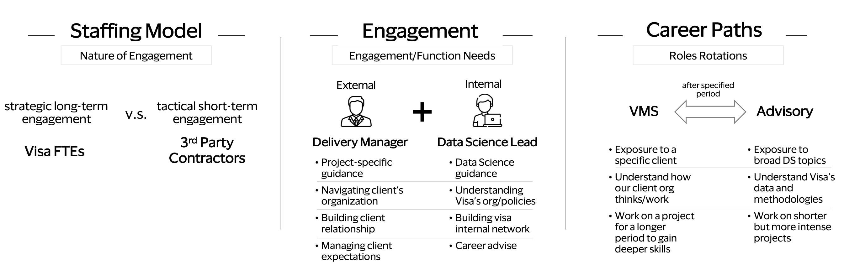
Managed services talent program
720027410
Notes:
At this stage, it is crucial to use sufficient amount of time to establish a clear and concise definition of how you will define talent within your business. Do not underestimate the influence of how you define things. It will greatly influence your Talent Management Program. If your talent definition is clear and simple it will help your organisation to be better able and find it easier to identify talents. They will also understand what Talent Management is all about. If you have too narrow a definition of talent then only a selected few will be seen as talents and developed accordingly. If it is too broad it will have little or no practical effect.
Some companies consider talent as something that all employees have. This very broad understanding of talent goes well in hand with a common definition of talent: “A natural ability to excel at a duty or action”.
Another perspective on talent, seen in a business context, is that in your company there are a group of employees that have a specific talent that your company can potentially benefit from. This group is often called High Potentials (HiPo’s). CEB (formerly Corporate Executive Board) has defined talent / HiPo’s as seen below:
The staffing Model we hire based on the project where we decide we need to go with FTE’s or 3rd Party Contractors.
For every product there will be a Delivery Manager who is the owner of the product who need to take care of entire life cycle of the product.
Data Science Lead will be leading the project and developing the technical stuff.
There are multiple career paths our organization provides, even a person can switch to cross technologies if he is interested.

Slide 11
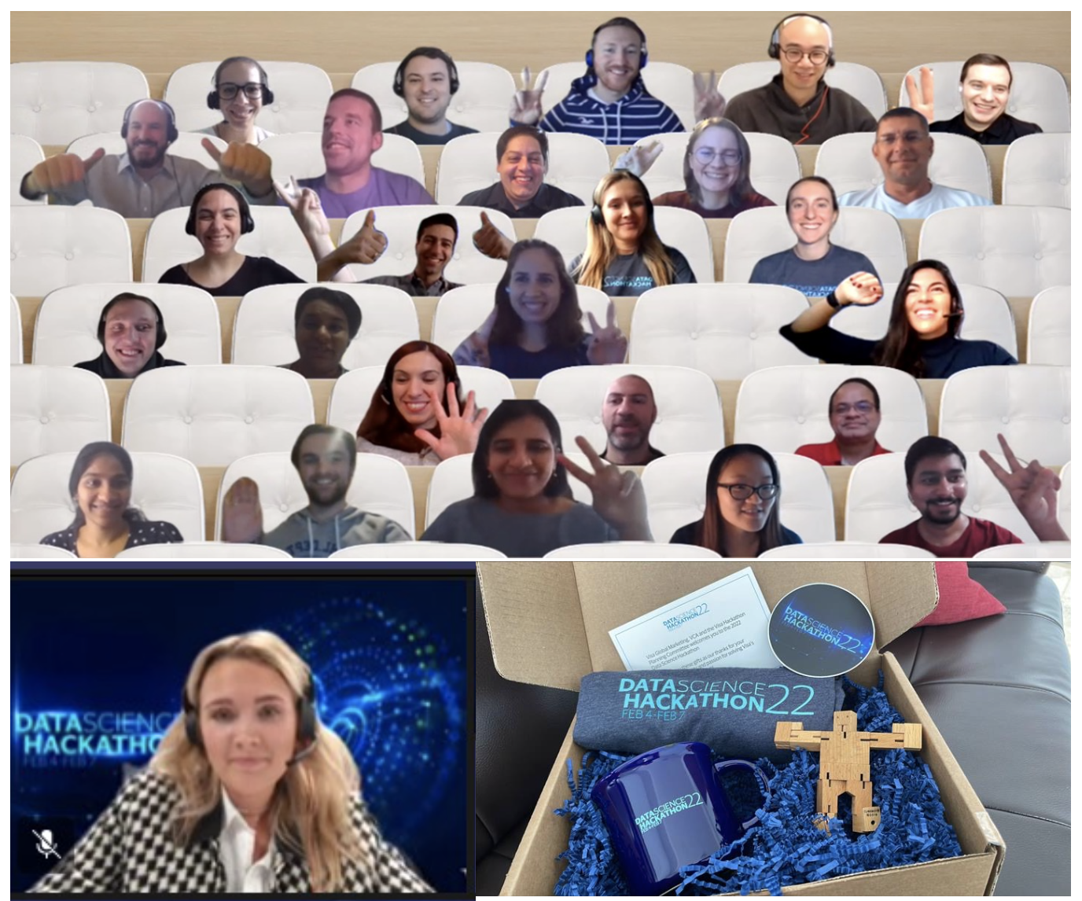
Hackathon 2022
720027410
Notes:
A hackathon, also known as a codefest, is a social coding event that brings computer programmers and other interested people together to improve upon or build a new software program.
The word hackathon is a portmanteau of the words hacker, which means clever programmer, and marathon, an event marked by endurance.
Types of hackathons
Hackathons vary in objectives and themes. Hackathons organized as a platform for creating applications such as Mobile apps, operating system variations, web and video game upgrading are branded as niche hackathons. Altruistic hackathons are those where participants work to find solutions for problems such as public transport systems, education and disaster response.
Corporate hackathons organized by companies like Amazon, Google, and Microsoft are developed to encourage employees to participate in new product development. Language or programming hackathons are dedicated to creating specific programming language or framework applications such as C++ or Java, Python, Scala, Go.
Organizing a hackathon
The first step when organizing a hackathon is to determine the goals of the hackathon. Having a clear set of rules for the hackathon is another crucial step. The participants should be aware of the mission, the time allotted and the sources they can refer to when creating their products.
It is also important that organizers create a positive, collaborative ambiance at the hackathon venue. The gatherings should encourage informal brainstorming ideas for new products, services and projects.
At the end of a hackathon, a panel of judges usually hands out prizes to the winning team or projects.
Pros and cons of hackathons
Hackathons bring people with technical backgrounds together to form teams to solve a problem or develop new ideas.
Hackathons can help participants hone their IT skills, meet people and work with others in their field. Corporate hackathons encourage employees to innovate, foster team building and provide opportunities to cross-collaborate across departments.
Hackathons can potentially create more stress for employees. The ideas typically generated through a hackathon can prove complicated as well, because there is often no formal way to sift through or evaluate the ideas. Hackathons also involve time, cost and other resources to produce, with no guaranteed return on investment.
We had a Data Science hackathon this year and received a wonderful ideas from the participants, some of them went to file a patent. This event provides an opportunity to the participants to come up with new ideas and work with other people in the organization.

Slide 12

Thanks!
Any questions?
You can find me at
sj565@exeter.ac.uk
720027410
Notes:
Thanks, if you have any questions, please reach out to me at sj565@exeter.ac.uk

